Slide 1

Unit-8 Database Security
Database Management Systems (DBMS)
GTU # 3130703
Prof. Firoz A Sherasiya
Computer Engineering Department
firoz.sherasiya@darshan.ac.in
9879879861

Slide 2

Looping
Outline
What is data security?
Security v/s Integrity
Authentication v/s Authorization
Data encryption
Access control
DAC (Discretionary access control)
MAC (Mandatory access control)
RBAC models
Intrusion detection
SQL injection

Slide 3
What is data security?
Section – 1

Slide 4
What is data security?
Data security is the protection of the data from unauthorized users.
Only the authorized users are allowed to access the data.
Most of the users are allowed to access a part of database i.e., the data that is related to them or related to their department.
Mostly, the DBA or head of department can access all the data in the database.
Some users may be permitted only to retrieve data, whereas others are allowed to retrieve as well as to update data.

Slide 5
Security v/s Integrity
Section – 2

Slide 6
Security v/s Integrity
Security | Integrity
Data security deals with protection of data. | Data integrity deals with the validity of data.
Data security is making sure that only the people who should have access to the data are the only ones who can access the data. | Data integrity is making sure that the data is correct and not corrupt.
Data security avoids from unauthorized access of data. | Data integrity avoids from human errors, when data is entered.
Data security is implemented through user account (passwords). | Data integrity is implemented through constraints such as Primary key, Foreign key, Check constraints etc.

Slide 7
Authentication v/s Authorization
Section – 3

Slide 8
Authentication v/s Authorization
Authentication | Authorization
It is the process of validating a user on the credentials (username and password). | It is the process of verifying whether access is allowed or not.
Logging on to a PC or some website or app with username and password is authentication. | Accessing a file (data) from hard disk or some database is authorization.
It is the process of verifying who you are. | It is the process of verifying what you are authorized to do or not to do.
It is providing integrity control and security to the data. | It is protecting the data to ensure privacy and access control of data.

Slide 9
What is audit trail (audit log)?
An audit trail (audit log) is a record which will be generated for each and every transactions.
It will keep certain information about the transaction.
An audit trail (audit log) records
Who (user or the application program and a transaction number)
When (date and time)
From Where (location of the user and/or terminal)
What (identification of the data affected, as well as a before-and-after image of that portion of the database that was affected by the update operation)

Slide 10
Data encryption
Section – 4

Slide 11





What is data encryption?
Encryption is a security method in which information is encoded in such a way that only authorized user can read (understand) it.
It uses encryption algorithm to generate ciphertext that can only be read if decrypted.
Sender
Unauthorized
Receiver
Hello
Plaintext
Plaintext
Hello
Encryption
Decryption
Khoor
Ciphertext
Ciphertext
Khoor
Should not access OR cant understand

Slide 12
What is data encryption?
Data encryption is the process of encoding (translating) a message or information in such a way that only authorized persons can access it and those who are not authorized cannot.
Encryption is the process of translating plaintext data (plaintext) into something that appears to be meaningless (ciphertext).
Decryption is the process of converting ciphertext back to plaintext.
Types of Encryption
Symmetric key encryption / Private key encryption
Asymmetric key encryption / Public key encryption

Slide 13
Types of Encryption
Symmetric key encryption
Encryption and decryption keys are the same.
The same key is used by the sender to encrypt the data, and again by the receiver to decrypt the data.
Symmetric key encryption is fast in execution.
Asymmetric key encryption
Encryption and decryption keys are the different (Public Key and Private Key).
Messages are encrypted by sender with one key (Public Key) and can be decrypted by receiver only by the other key (Private Key).
Asymmetric key encryption is slow in execution due to the high computational burden.

Slide 14
Access control methods
Section – 5

Slide 15
Access control methods of data security
There are three different methods of data access control:
Discretionary access control (DAC)
Mandatory access control (MAC)
Role based access control (RBAC)

Slide 16




Discretionary access control
In discretionary access control (DAC), the owner of the object specifies (decides) which subjects (user) can access the object.
In this method a single user can have different rights on different objects, as well as different user can have different rights on the same objects.
Student
HOD
Student
Read (Partial rights)
Partial table (Only 1 tuple)
Read and Write (Full rights)
On entire table (3 tuples)
RollNo | Name | Branch | Sem | SPI | BL
101 | Raju | CE | 3 | 6 | 1
101 | Mitesh | CE | 5 | 9 | 0
102 | Jay | CE | 3 | 8 | 0
Read (Partial rights)
Partial table (2 or 1 tuples)
Read and Write (Full rights)
Partial table (2 or 1 tuples)
Faculty
Coordinator

Slide 17
Discretionary access control
SQL support discretionary access control through the GRANT and REVOKE commands.
GRANT
This command gives rights to user for an object.
Syntax:- GRANT privilege ON object TO user [WITH GRANT OPTION]
REVOKE
This command takes back rights from user for an object.
Syntax:- REVOKE privilege ON object FROM user {RESTRICT/CASCADE}

Slide 18





Mandatory access control
In this method individual user cannot get rights.
But all the users as well as all the objects are classified into different categories.
Each user is assigned a clearance level and each object is assigned a security level.
A user can access object of particular security level only if he has proper clearance level.
The DBMS (system) determines whether the given user can read or write a given object based on some rules.
This rule makes sure that sensitive data can never be passed to a user without necessary clearance.
Top Secret | Secret | Confidential | Unclassified

Slide 19
Mandatory access control
Mandatory access control technique for multi-level security uses four components:
Subjects:- Such as users, accounts, programs etc.
Objects:- Such as relation (table), tuples (records), attribute (column), view etc.
Clearance level:- Such as top secret (TS), secret (S), confidential (C), Unclassified (U). Each subject is classified into one of these four classes.
Security level:- Such as top secret (TS), secret (S), confidential (C), Unclassified (U). Each object is classified into one of these four classes.
In the above system TS>S>C>U, where TS>S means class TS object is more sensitive than class S object.
A user can access data by following two rules
Security property:-
Security property states that a subject at a given security level may not read an object at a higher security level.
Star (*) security property:-
Star (*) property states that a subject at a given security level may not write to any object at a lower security level.

Slide 20
Role based access control (RBAC) rules
It restricts database access based on a person's role within an organization. The roles in RBAC refer to the levels of access that employees have to the network.
Employees are only allowed to access the information necessary to effectively perform their job duties.
Access can be based on several factors, such as authority, responsibility, and job competency.
In addition, access to computer resources can be limited to specific tasks such as the ability to view, create, or modify a file.
Lower-level employees usually do not have access to sensitive data if they do not need it to fulfil their responsibilities.
Using RBAC will help in securing your company’s sensitive data and important applications.

Slide 21
Intrusion detection
Section – 6

Slide 22
Intrusion detection
An Intrusion Detection System (IDS) is a system or software application that monitors network traffic or system for suspicious activity or policy violations and issues alerts when such activity is discovered.
It is a software application that scans a network or a system for harmful activity or policy breaching.
Any malicious venture or violation is normally reported either to an administrator or collected centrally using a security information and event management (SIEM) system.
A SIEM system integrates outputs from multiple sources and uses alarm filtering techniques to differentiate malicious activity from false alarms.

Slide 23
SQL injection
Section – 7

Slide 24
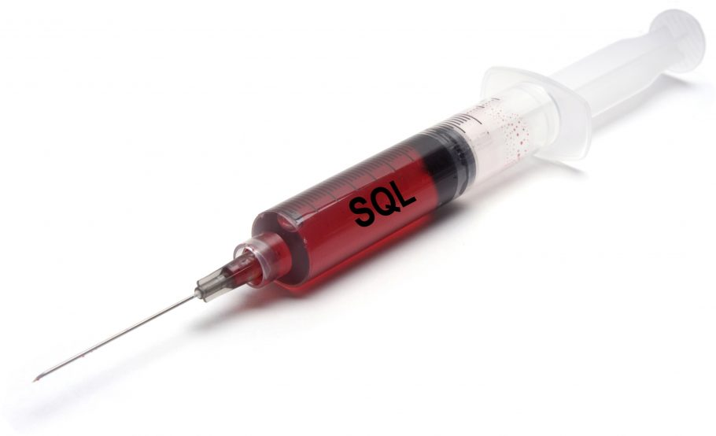
SQL injection
SQL injection, also known as SQLI, is a common attack vector that uses malicious SQL code for backend database manipulation to access information that was not intended to be displayed.
This information may include any number of items, including sensitive company data, user lists or private customer details.
A successful attack may result in the unauthorized viewing of user lists, the deletion of entire tables, gaining administrative rights to a database, all of which are highly detrimental to a business.

Slide 25
Questions asked in GTU
Explain Authorization and access control in brief.
What is the difference between data security and data integrity?
What is constraint? Explain types of constraints.

Slide 26
Database Management Systems (DBMS)
GTU # 3130703
Prof. Firoz A Sherasiya
Computer Engineering Department
firoz.sherasiya@darshan.ac.in
9879879861

